Slide 1
Let me briefly explain how the tablet interface looks like…

Slide 2
As a first prototype, our system only shows
ambient sound level (loudness, pitch) in each room of the house.

Slide 3
Let’s imagine that you’re living in a hypothetical two-floor home…

Slide 4
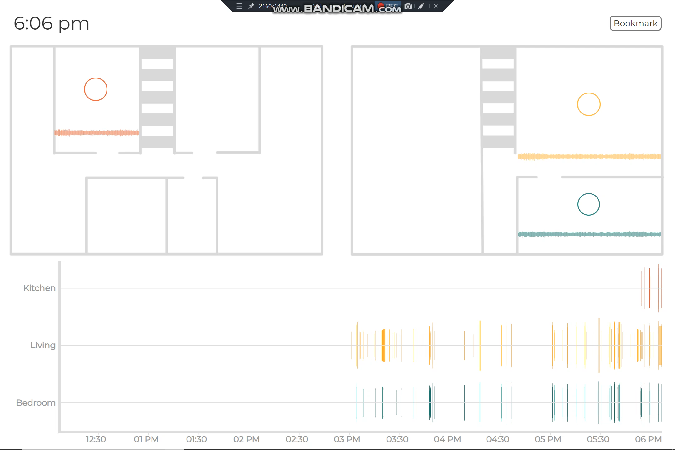
First floor
Second floor
And this is an approximate floorplan of your hypothetical home…

Slide 5

First floor
Second floor
Kitchen
Living Room
Bedroom
Say we install our tablets in three rooms of your house.

Slide 6
Then our sound awareness system will look something like this….

Slide 7
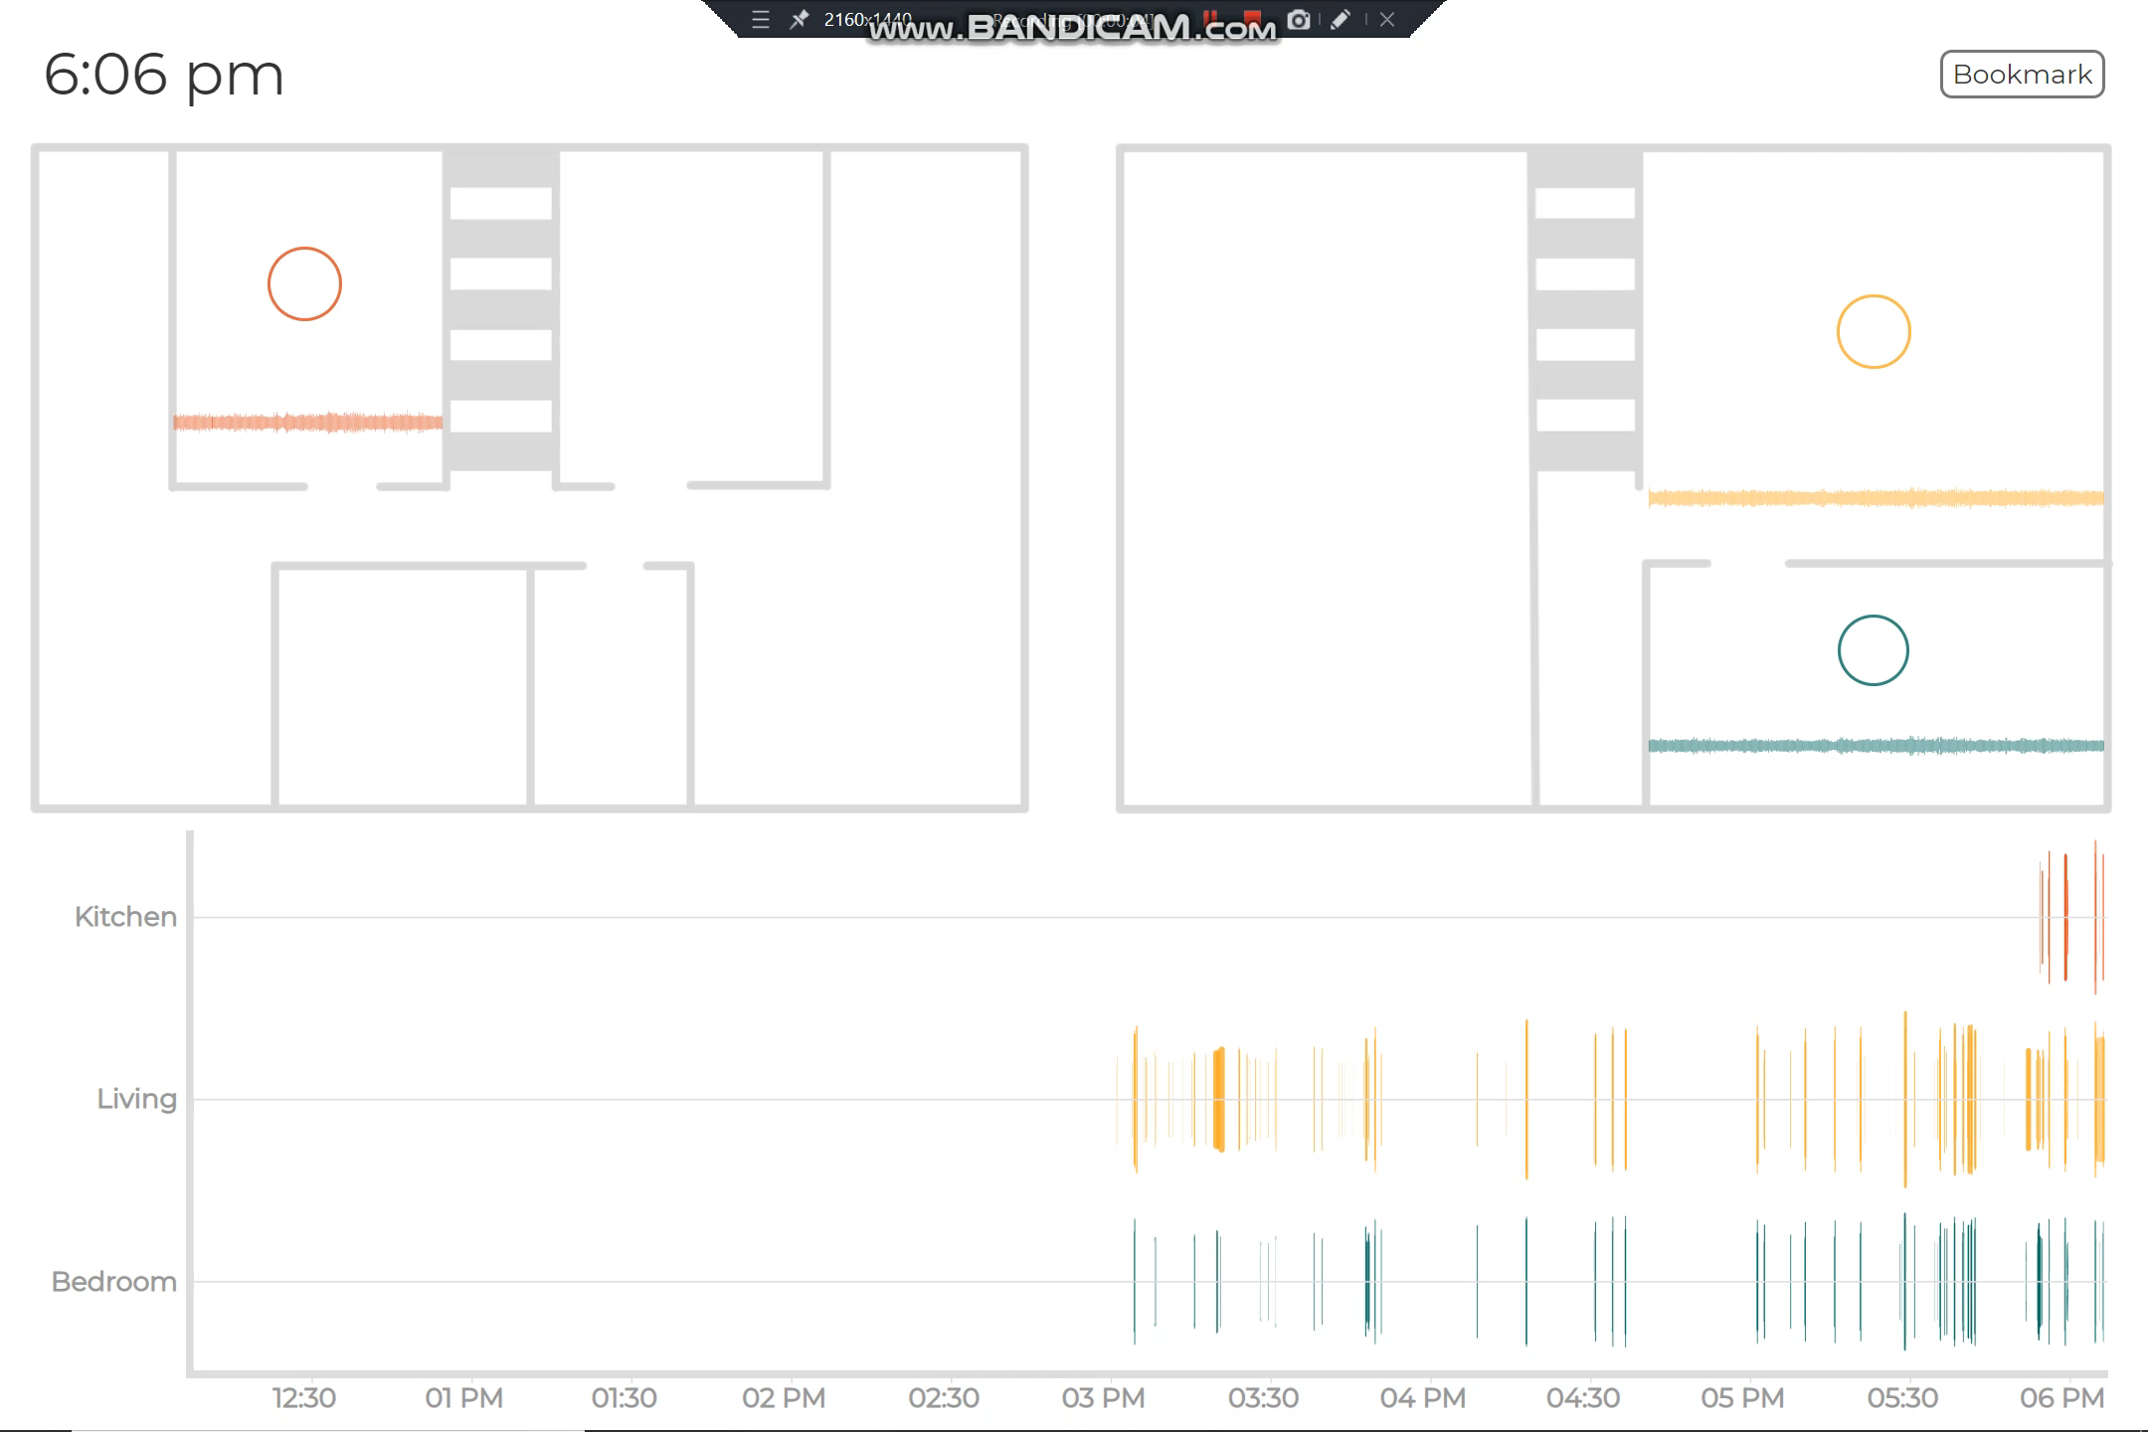

Slide 8
Now, let’s go through each element of the system.

Slide 10
This view, called the “floorplan view”, shows sound in each room containing the tablet.

Slide 11
This view, called the “history view”, shows history of sound in each room for past 6 hours.

Slide 12
Let’s walk through the elements of the floorplan view.

Slide 13
The waveform represents the sound level for 30 seconds.
This circle shows average loudness in the Kitchen for the last 6 hours.
Sometimes you’ll also see a lighter colored circle which shows the 30-min average loudness.

Slide 14
Before continuing further, recall the different rooms of the house…

Slide 15
Kitchen
Living Room
Bedroom

Slide 16
Now, imagine a live sound occurring in the living room…
This is how it will appear…

Slide 17


Slide 18
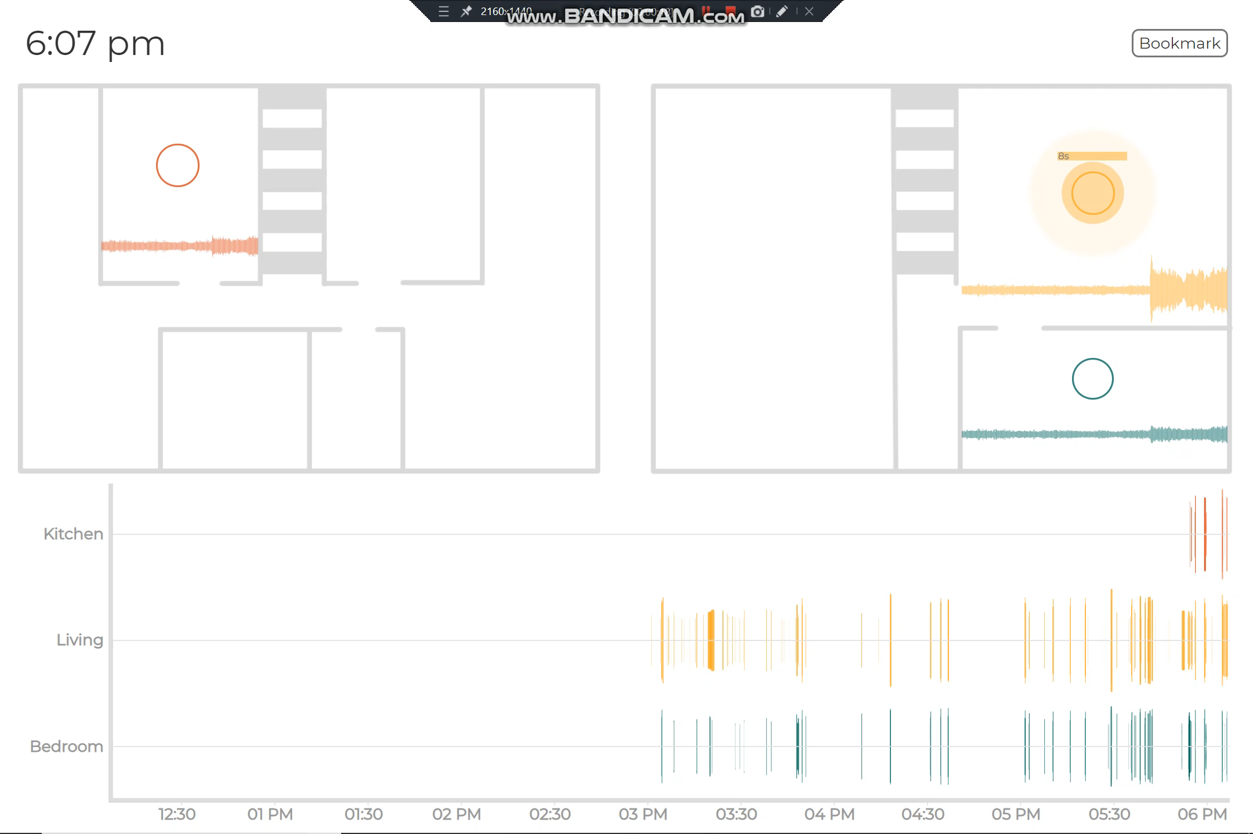
This bar here shows the duration of a live sound
The pulse shows a live sound occurring. The louder the sound, the bigger the pulse
You also saw how the waveform shows a sound

Slide 19
Now, the history view…

Slide 20
The height of a bar shows loudness, while the width shows duration of the sound
In the history view, each bar shows a single sound event from the past in a room

Slide 21
Though subtle, the colors also represent the pitch of sound.
Though subtle, the colors also represent the pitch of sound. The darker the colors, the higher the pitch of a sound.
Though subtle, the colors also represent the pitch of sound. The darker the colors, the higher the pitch of a sound. For example, microwave beep, a high pitch sound will appear dark in color.

Slide 22
That’s all!
That’s all! If you’d like to take a screenshot of the screen, you can do so by clicking on the bookmark button here.

Slide 23
You can keep this sheet for reference.

Slide 24
Sound Awareness System – Reference Sheet

Slide 25
To take a screenshot
6-hour average
30-min average
Duration bar
A live sound
30-sec waveform
sound history - height shows loudness, length shows duration, color darkness shows pitch

